Slide 1

LECTURE
(HOMEOPATHY)

Slide 2
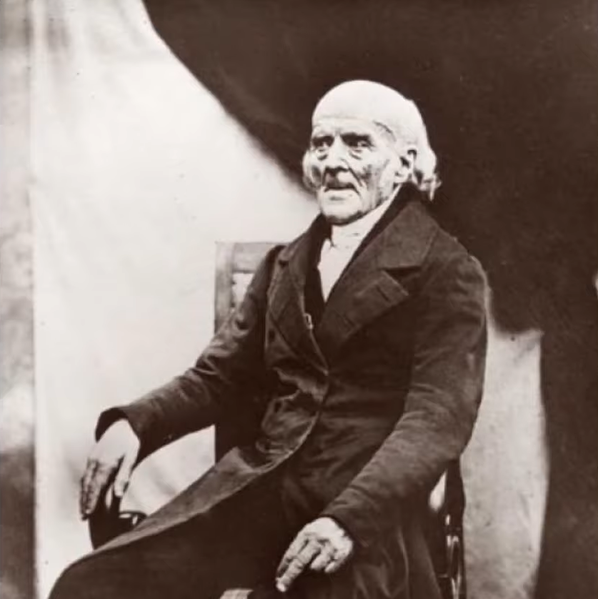
HISTORY OF MEDICINE
Dr. Samuel Hahnemann
Response to harshness of Allopathy
Medical Heresy

Slide 3
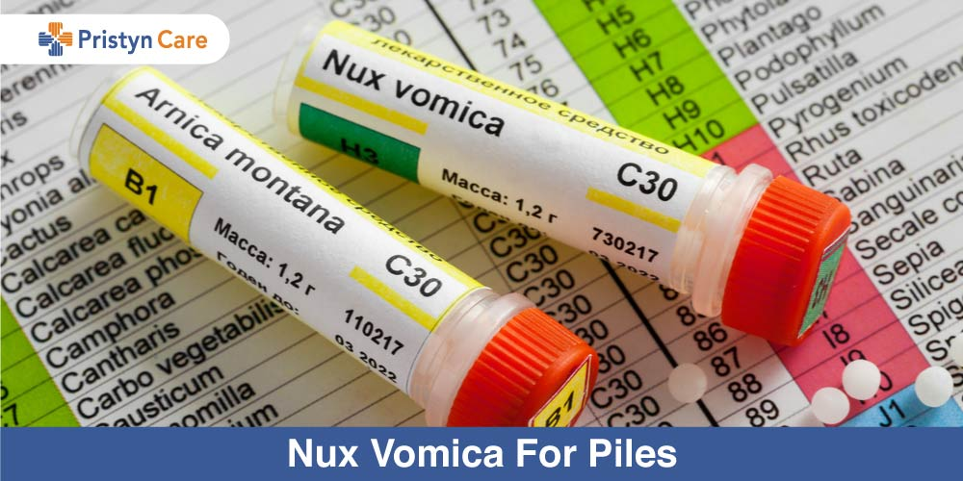
PRINCIPLES OF HOMEOPATHY
Water memory
Energetic medicine
Minimum dose
Similars
Symptoms

Slide 4
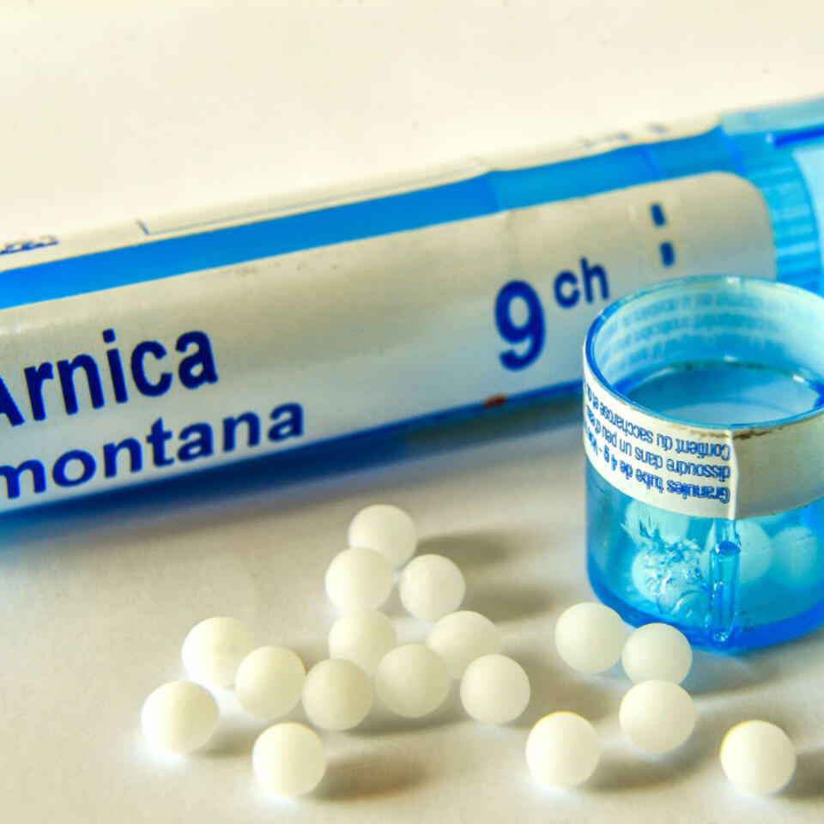
RESEARCH
Cast studies
Nano particles
Energetic vs. Biomolecular

Slide 5
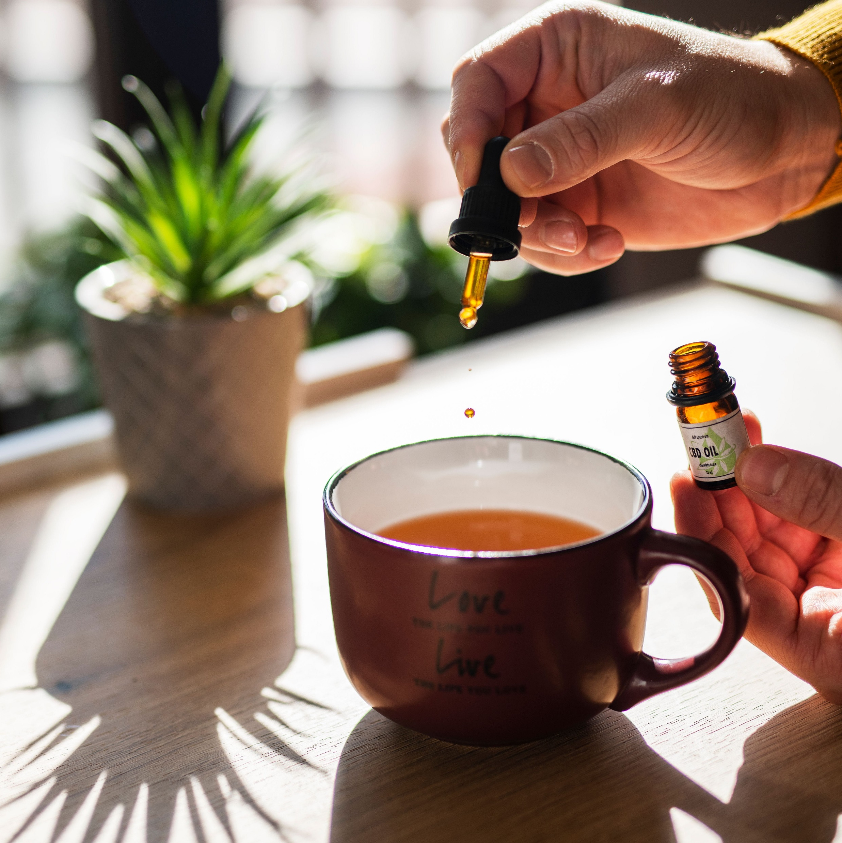
USED TODAY
Countries
2nd largest Medical System
200 million users
40/42 European countries
India: 2million Homeopathic doctors

Slide 6
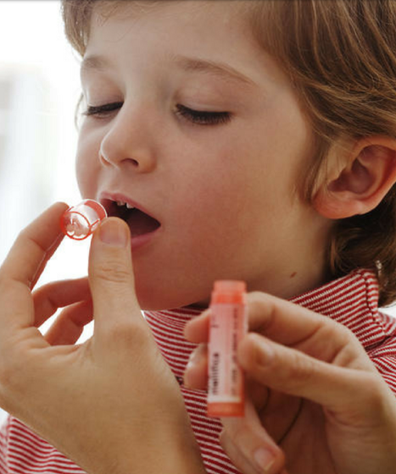
HOW TO USE HOMEOPATHY
Do not touch remedies
Dilutions
Potencies
Expiration
Shake before use
Can use on pets and infants

Slide 7
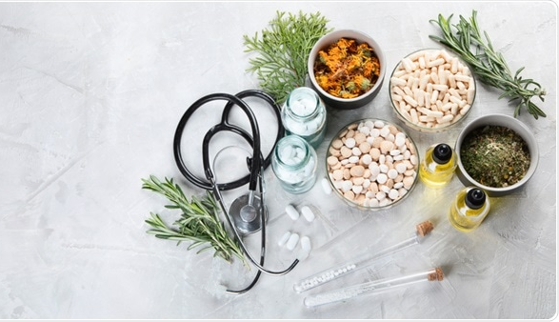
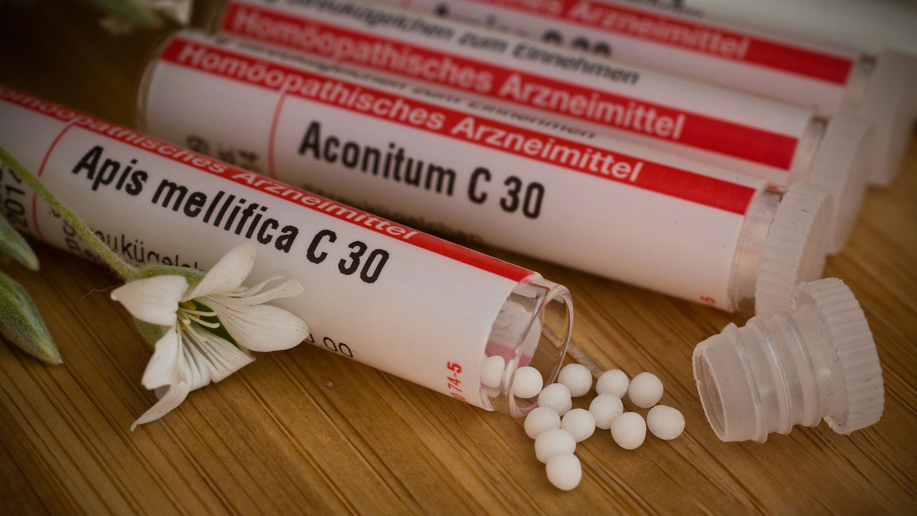
KEY REMEDIES
Arnica
Belladona
Chamomilla
Ignatia
Rhus Tox
Pulsatilla

Slide 8
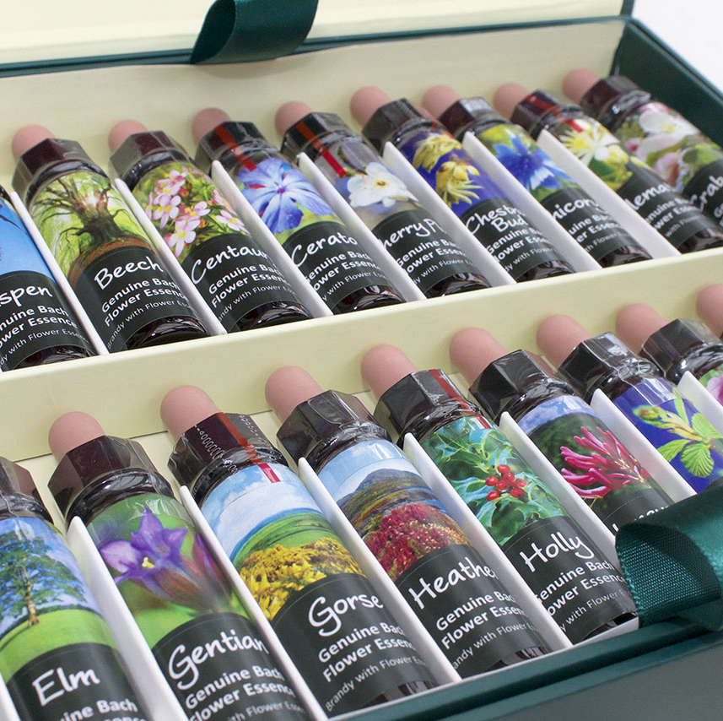
BACH FLOWER REMEDIES

Slide 9

STORIES
Emotional stress
Epilepsy
Bee sting
Surgery
Seasonal allergies

Slide 10
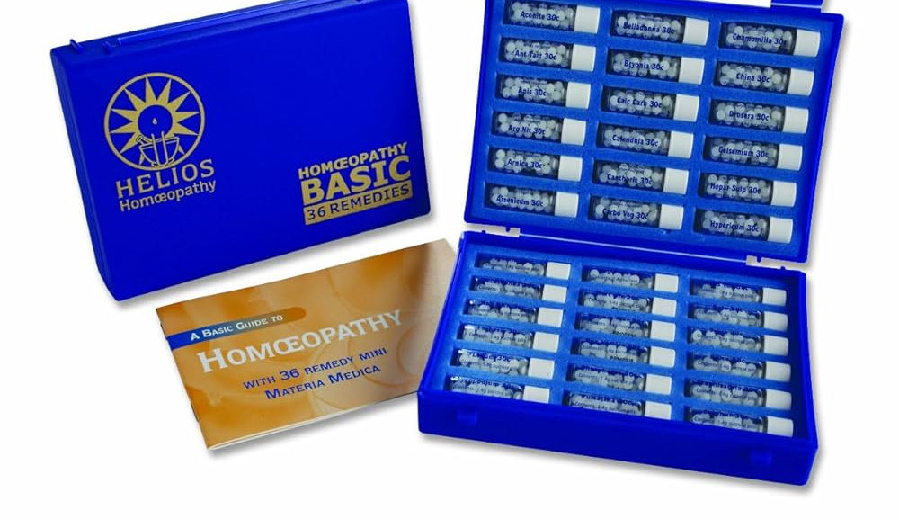
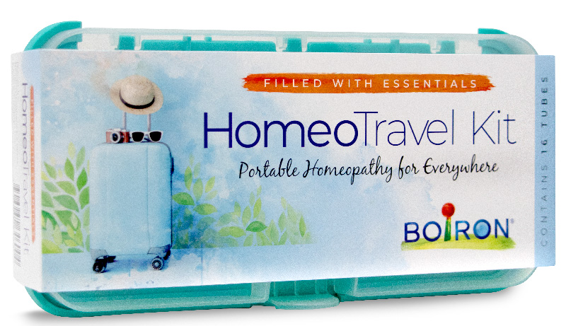
KITS
Homeopathy Book
Homeopathy Kit

Slide 11
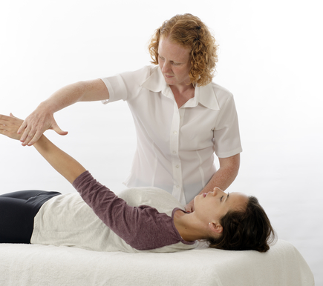
MUSCLE TESTING
Find a strong muscle
Provocation
Proving

Slide 12
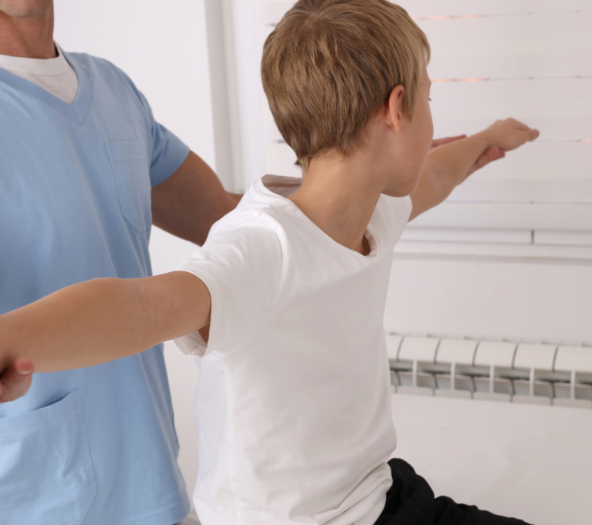
PRACTICE MUSCLE TESTING TOGETHER
Water vs. rat poison (chemical)
Beauty vs. ugly (thought)

Slide 13
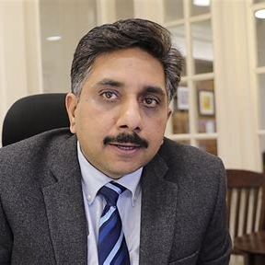
OTHER RESOURCES
Dr. Vikas Sharma
https://www.drhomeo.com/diseases/

