Slide 1
ANXIETY SEMINAR
By Dr. Shane Martin

Slide 2

INTRODUCTION TO MEDICINE

Slide 3

INTRODUCTION TO ANXIETY
What makes you anxious?
Majority of anxiety is physiological

Slide 4
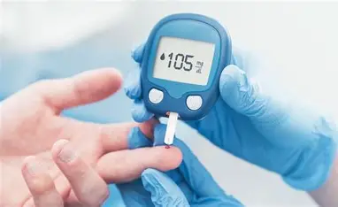
BLOOD SUGAR
Cases
Treatment

Slide 5
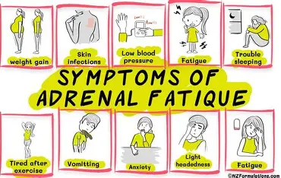
ADRENAL FATIGUE
Cases
Treatment

Slide 6
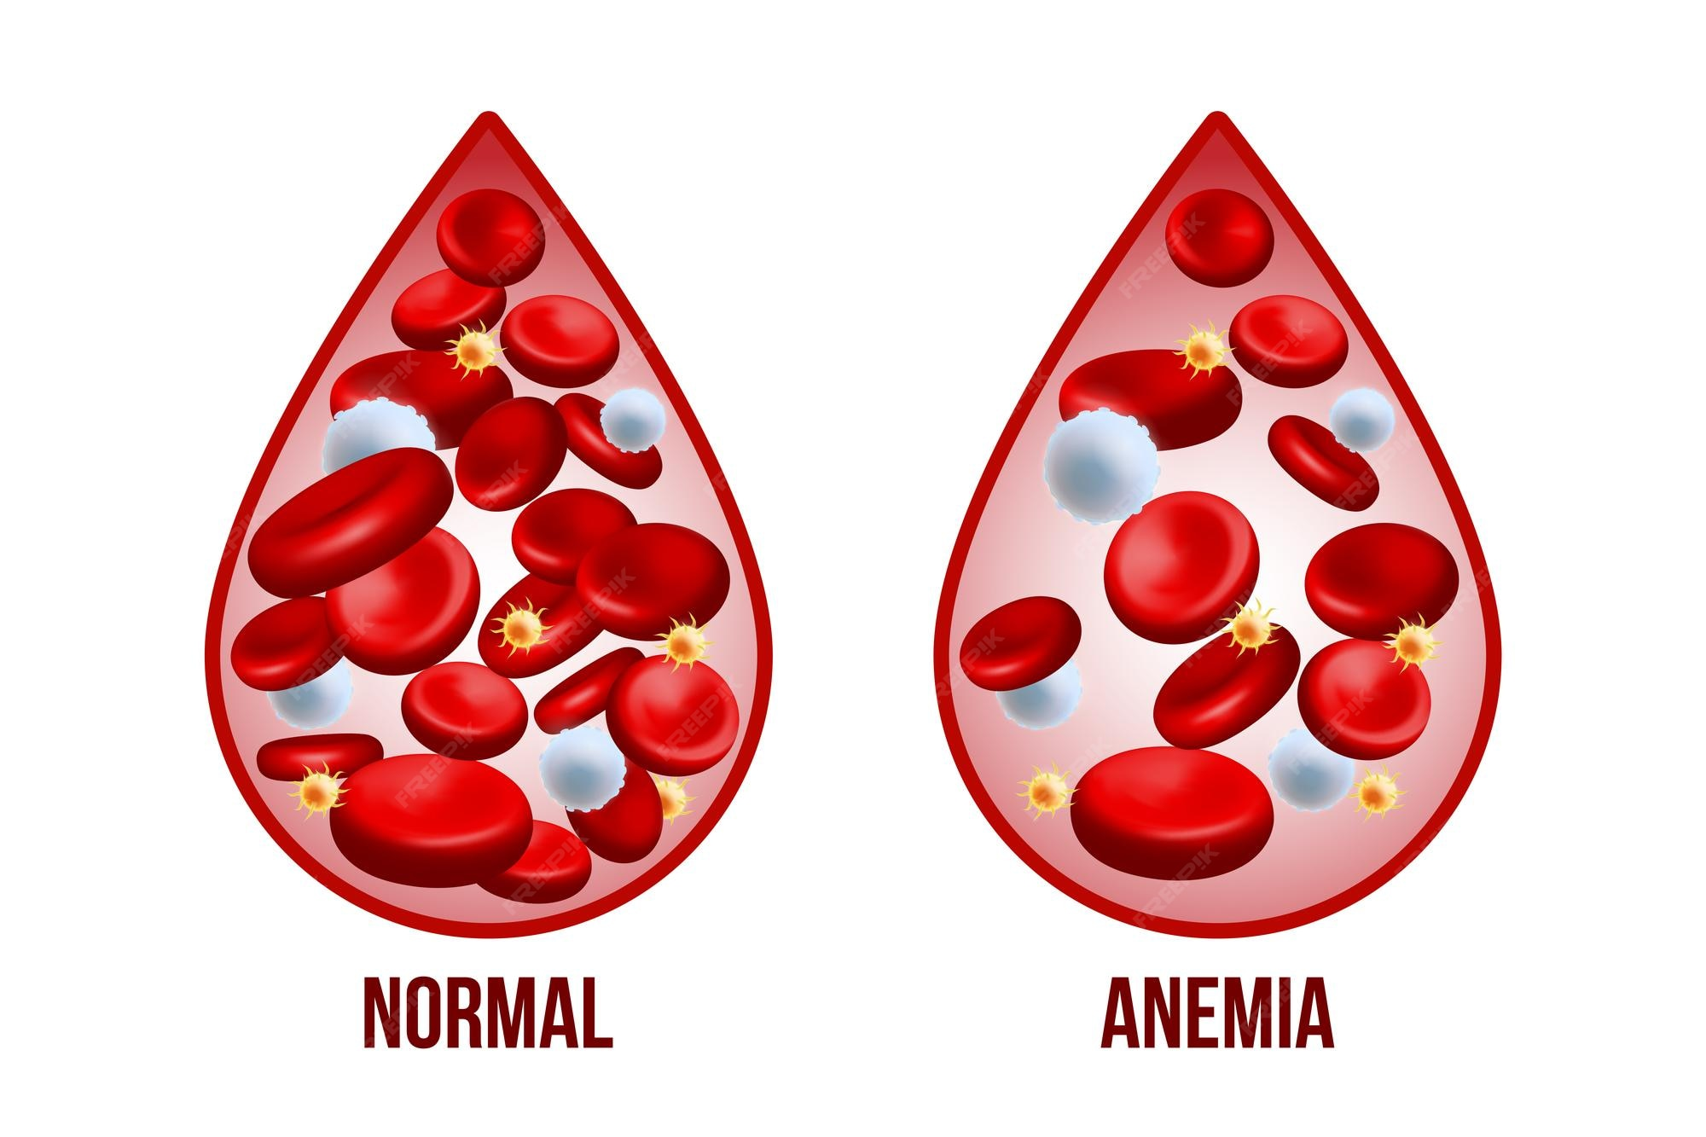
ANEMIA
Cases
Treatment

Slide 7
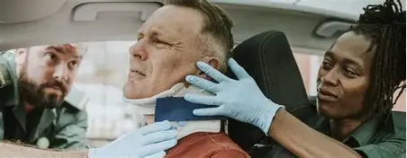
TRAUMA
Cases
Treatment

Slide 8
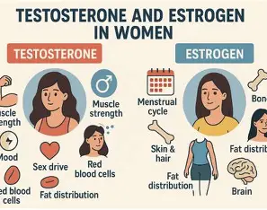
HORMONES
Cases
Treatment

Slide 9

NEUTRACEUTICALS
Common Recommendations
Phosphatidylserine
Ignatia and Chamamilla
Kava

Slide 10


BACK FLOWER REMEDIES

Slide 11
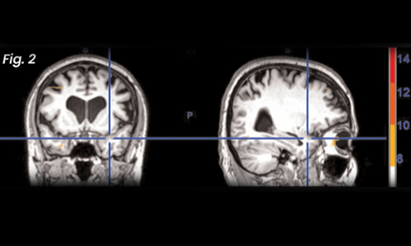
NEURO EMOTIONAL TECHNIQUE

Slide 12
FOR TODAY
Sign up to day for a New Patient Visit and get one of the following:
Free lab work
One free supplement
ANOTHER OPTION
$40 Ten POINT CHECK UP (DIAGNOSE ONLY):
Hormones, Digestion, Allergies, Physical Problems, Infections, Iridology

Slide 13

QUESTIONS?

